Slide 1
1.5.3 Walkthrough #4 bouncing_ball.py wrapping_ball.py
Computer Science and Software Engineering
© 2014 Project Lead The Way, Inc.

Slide 2
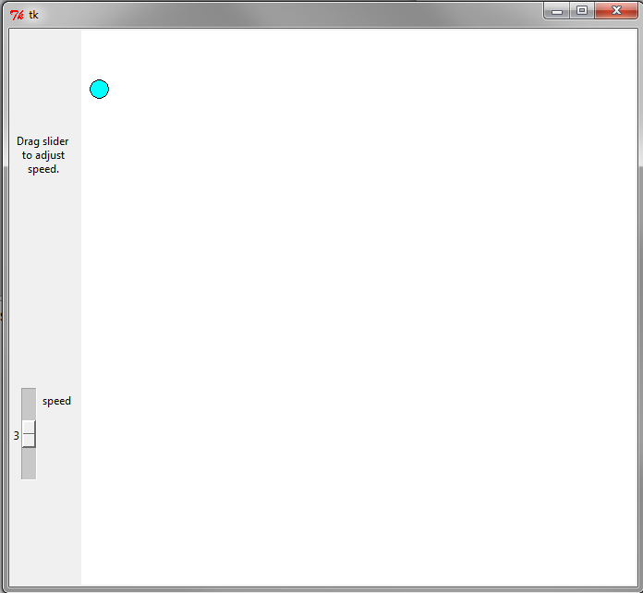
Demo: bouncing_ball.py
Notes:
Run this program or watch your teacher demonstrate it. The slider changes the ball’s speed across the canvas. The ball bounces from the canvas’ edges.

Slide 3
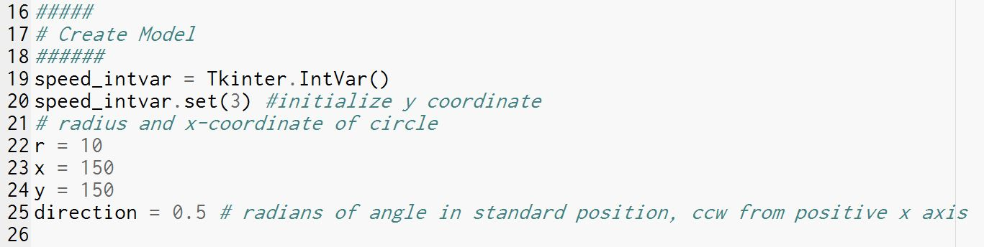
Model
Notes:
The program will need an IntVar for the speed widget. The variables r, x, y, and direction will reflect the ball’s location. Actually, r, x, and y are redundant; the canvas keeps track of those. But when we ask the canvas to tell us where the ball is, we will need variables to store those results.

Slide 4
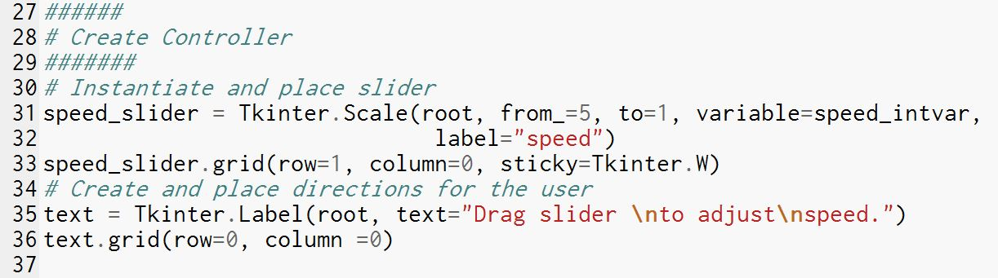
Controller
Notes:
The slider is the only control. Here a Label explains what to do, too.

Slide 5
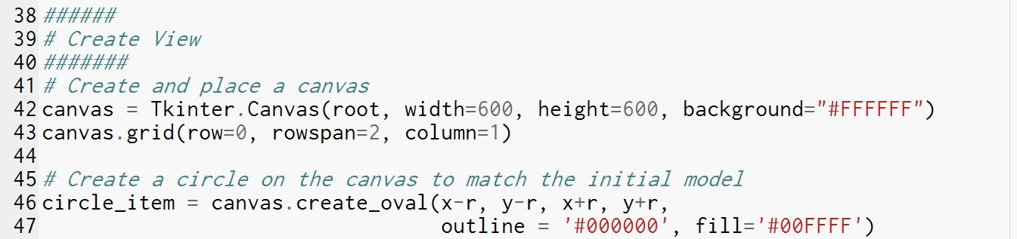
View
Notes:
The Canvas displays a single item, an oval created on line 46.

Slide 6
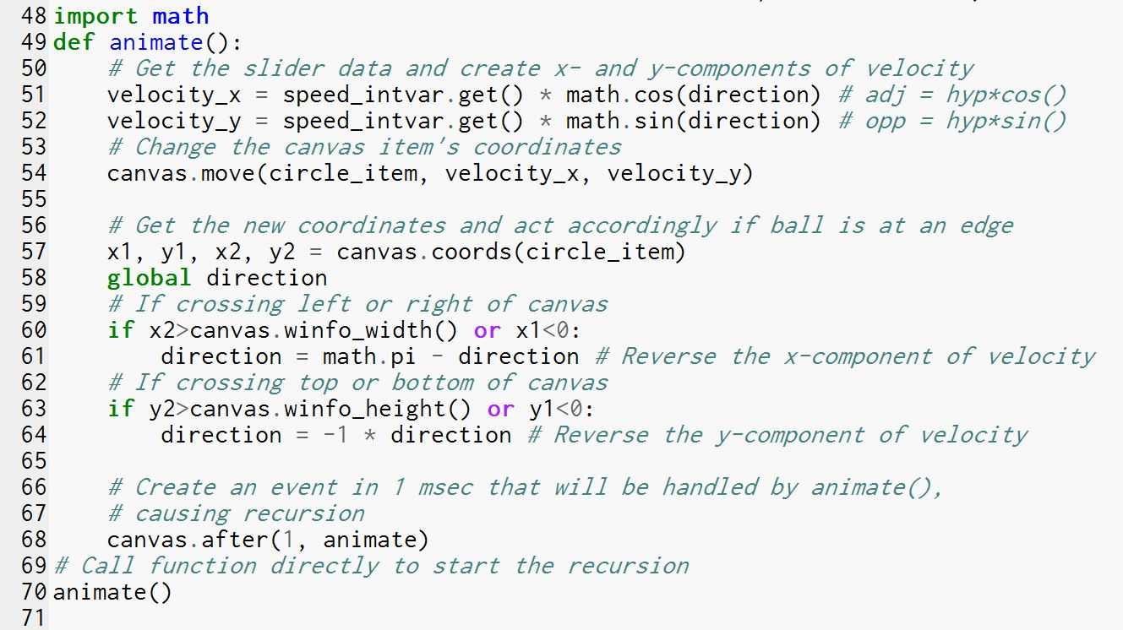
Animation
Notes:
Lines 51 and 52 require some advanced math. Don’t worry about them. The meat of this handler is on line 54 and line 68. Line 54 moves the circle on the canvas. Line 68 says to call this handler again after 1 millisecond. Hey! That means this handler calls itself! Yes, that’s recursion, discussed on the next slide.
Lines 57 through 64 compare the item’s location to the edges of the canvas. If the item is off the canvas, they change the direction of the item so it will head back onto the canvas.

Slide 7

CS Concept: Recursion
Recursion is when a function calls itself
A base case ends the recursion
One of four building blocks:
Sequence
Selection
Iteration
Recursion
Image courtesy
Steve Mould 2012
Notes:
The animate() handler in the last slide called itself. This is known as recursion. Recursion is one of the four basic building blocks of programs. At the very beginning of the course, we learned about the other three building blocks. Recursion is hardly touched on in this course.
To review: Instructions are sequenced; they happen one after another.
Branching and iteration change this sequence. Conditional statements can be evaluated to select the next statement from two options (if-else). Conditional statements can also be evaluated to iterate across a block of instructions (while, for).
Recursion is the final building block. Unlike iteration, recursion doesn’t finish with a block of code before repeating it. The recursion starts the recursive block over again, and over and over, without finishing any of them. Finally, (hopefully, if we are to avoid infinite recursion), one call to the function does finish and return to the previous call, which is finally able to return to the previous call, which returns to the one before that, and so on all the way back up to the first recursive call.

Slide 8
CS Concept: Recursion
Recursion is when a function calls itself
A base case ends the recursion
Example:
Image courtesy
Steve Mould 2012
Notes:
In this example, the image processing function that created this image only needs to go so far into the smaller and smaller depths. At some point, it can say “I’m done!” That is the base case, the case where the recursive call returns a value instead of making another recursive call.

Slide 9
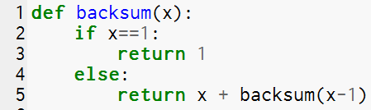

CS Concept: Recursion
Recursion is when a function calls itself
A base case ends the recursion
Example:
Notes:
In this example, backsum(6) calculates 6+5+4+3+2+1.
How does it do this?
Does the recursive function ever “miss” the base case?
What will happen if you evaluate backsum(6.5)? (Hint: please don’t try it.)

Slide 10
Demo: wrapping_ball.py
Notes:
Your teacher will demonstrate the wrapping_ball.py program, and then you will create it. The ball bounces off the top and bottom but wraps around left and right.

